Slide 1
JManager
M. de Jong

Slide 2
JManager (1/5)
JManager can help you do book keeping of many ROOT histograms / graphs
  same histogram / graph for different modules, PMTs, etc.
It simply extends the functionality of an STD map
  it has a master ROOT histogram, graph or other TObject
    to be provided by the user to the constructor
  it creates “slave” histograms on the fly
    name of histogram is obtained by replacing a wild card character in the name of the master by the corresponding key
  it writes all histograms to file with a single call

Slide 3
JManager (2/5)
Implementation:
template<class JKey_t, class JValue_t>
class JManager :
public JPointer<JValue_t>, // master histogram
public std::map<JKey_t, JValue_t*> // STD map
{
JManager(JValue_t* master); // master histogram
void Write(const char* file_name); // save data to file
};

Slide 4
JManager (3/5)
How does this work?
  map operator […] is customized
    it checks for the availability of the histogram associated with given key
    creates new histogram if necessary based on the master histogram
    returns pointer to valid histogram
map[key]->Fill(x); // will work if map manages a TH1D

Slide 5
JManager (4/5)
What about the key?
  normal less-than operator < should be defined
    conform STD map
    to find the correct histogram for a given key
  STD output stream operator should be defined
    ostream& operator<<(ostream&, const JKey_t&);
    to create a name for the new histogram

Slide 6
JManager (5/5)
What about the master?
  wild card in the name of the master is replaced by textual representation of the key of the slave

Slide 7
Example (1/3)
JGIZMO::JManager<int, TH1D> map(new TH1D("M_[%]", …));
for ( ; ; ) {
:
for (JDAQSuperFrame::const_iterator
hit = frame->begin();
hit != frame->end();
hit++) {
map[frame-getModuleID()]->Fill(hit->getT());
}
}
map.Write(“example.root”);

Slide 8
Example (2/3)
JPlot1D can be used to plot the histograms
  JPlot1D \
  -f example.root:M \ select all histograms with M.*
  -\> "t [ns]“ \ draw x-axis label
  -L TR \ draw legend¶
  -T "example“ \ draw title
  -o example.gif save graphics output to file
  see result on next slide
¶ Note that JPlot1D will take text between [..] as label.

Slide 9
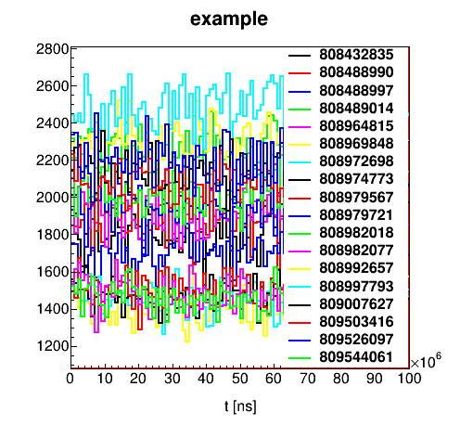
Example (3/3)

