Slide 1
Reconstruction
of
muon trajectories
Workshop on reconstruction
7−9 December 2016, Paris
M. de Jong

Slide 2
Introduction (1/5)
The fit of a muon trajectory to the data is
a non-linear problem
  in the absence of light scattering and for a given direction of the muon,
  the problem has a linear solution [ANTARES-SOFT-2007-001]
The PDF of the arrival time of Cherenkov light is
a multi-dimensional function
  calculation for direct and single-scattered light exists [ANTARES-SOFT-2010-002]
  first derivatives of PDF are zero when fit parameters are too far off from true muon

Slide 3









Introduction (2/5)
PMT
R
muon

Slide 4
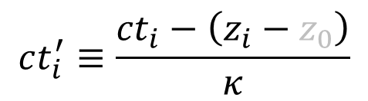
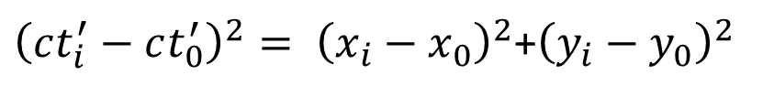
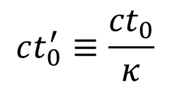
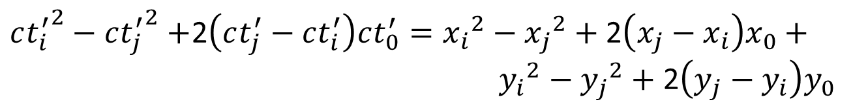
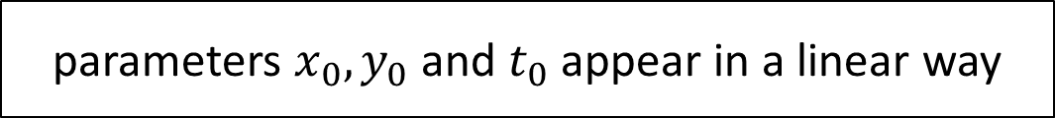
Introduction (3/5)

Slide 5
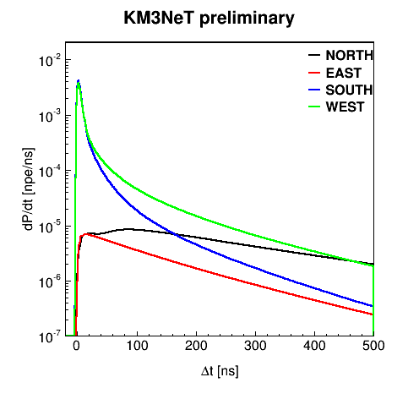
Introduction (4/5)
PMT
50 m
1 TeV muon

Slide 6
Introduction (5/5)
JPrefit
  input JDAQEvent standard DAQ data format
  output vector<JFit>
JSimplex
  I/O vector<JFit>
JGandalf
  I/O vector<JFit>
JEnergy intermediate data format
  I/O vector<JFit>
JStart
  I/O vector<JFit>
JEvt
  input vector<JFit>
  output Evt standard offline data format

Slide 7

JPrefit

Slide 8




Covariance matrix (1/3)

Slide 9


Covariance matrix (2/3)
¶ Assumption of Gaussian errors – add errors in quadrature.

Slide 10
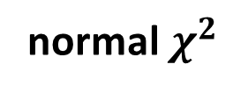
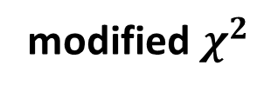
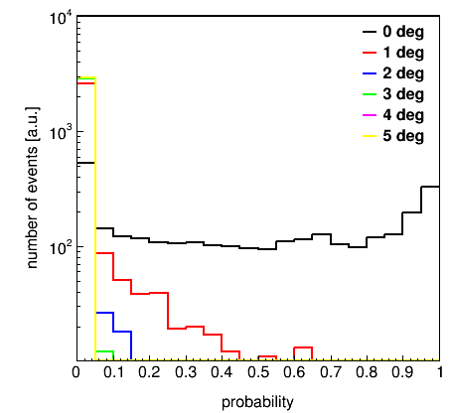
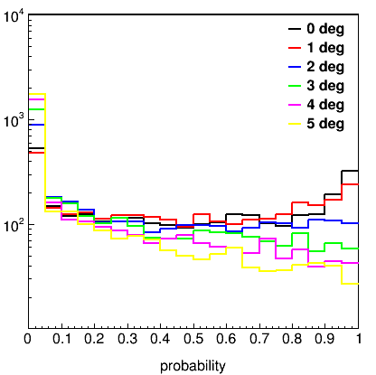
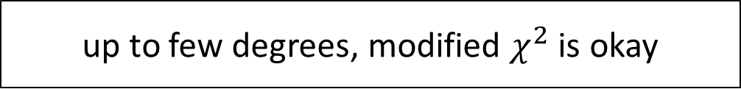
Covariance matrix (3/3)
Rotation of true muon
around barycentre
Rotation of true muon
around its barycentre

Slide 11

JSimplex

Slide 12

JGandalf

Slide 13

JEnergy

Slide 14

JStart

Slide 15
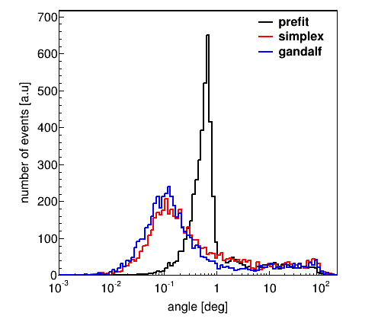
Angular resolution (1/4)
“out of the box”
smallest angle
from 12 best prefits
on 1 degree grid

Slide 16
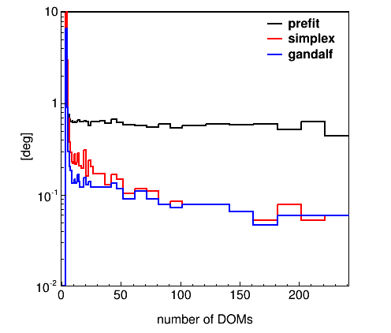
Angular resolution (2/4)
“out of the box”
median
~ 4 arcmin

Slide 17
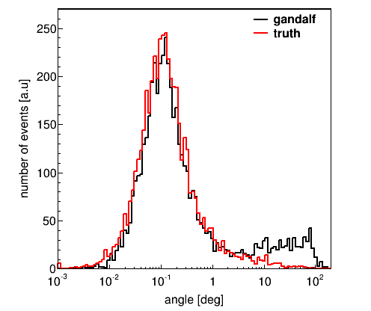
Angular resolution (3/4)
start value = Monte Carlo truth
resolution
due
to PDF
inefficiency
due
to local minima

Slide 18
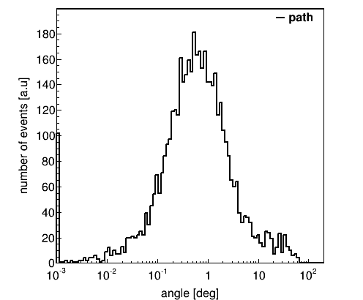
Angular resolution (4/4)
idem, but no time information

Slide 19
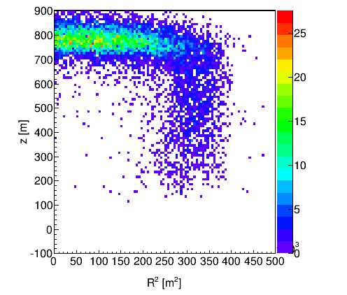
Start position
Atmospheric muons with energy E ≥ 10 TeV

Slide 20
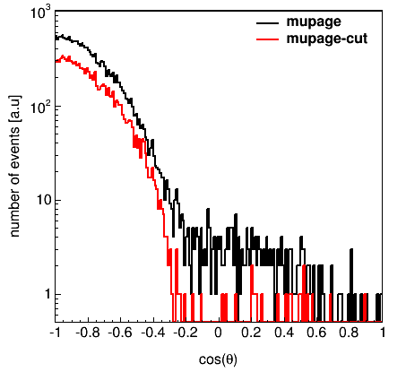
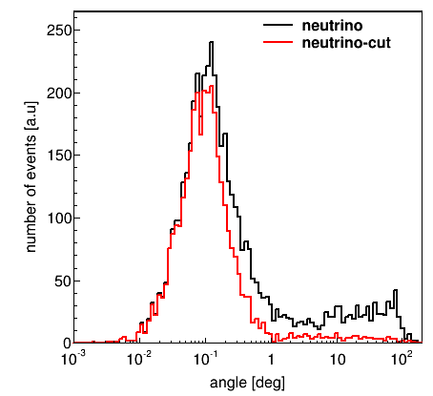
number of photo-electrons
muons
neutrinos
NPE ≥ 10
NPE ≥ 10

Slide 21
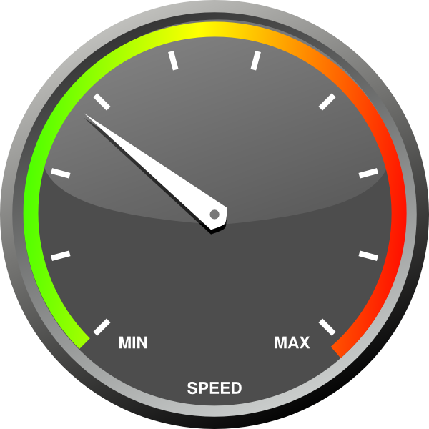
CPU usage (1/2)

Slide 22
CPU usage (2/2)
Application | Live time [s] | CPU time§ [s] | Ratio CPU/Live
MUPAGE¶ | 2530 | ? | ?
JSirene | 2530 | 10328 | 4
JTriggerEfficiency | 2530 | 9914 | 4
JPrefit | 2530 | 14263 | 6
JSimplex | 2530 | 1388 | ½
JGandalf | 2530 | 7087 | 3
JEnergy | 2530 | 2757 | 1
Total | 2530 | 45737 | 18
¶ Threshold 100 GeV
§ 1 ARCA block; Intel(R) Core(TM) i5-2400 CPU @ 3.10GHz

Slide 23
Summary
Jpp constitutes a general purpose framework for a.o. fitting models to data
  cluster algorithms
  permutations
  PDFs, PDFs and more PDFs
  linear estimators
  minimisers

Slide 24
Outlook
JPrefit − JSimplex − JGandalf − JEnergy − JStart
  excellent performance
  low CPU usage
  room for improvements
    fine tuning parameters (< 10)
    selection of start values
    PDF optimisation
    modelling of bremsstrahlung
    shorten chain
JSirene
  run, test, be happy (or not)
  prepare input from other applications…

