Slide 1
New trigger for ORCA
M. de Jong

Slide 2


Introduction (1/2)
Shower trigger based on a mix of L1 & L0 hits
Total rates
  $R_{L0}≅300 MHz$
  $R_{L1}≅ 2 MHz$
Typical time window
  $∆T ≅100 ns$
$$R_{L0}× ∆T ≫ 1$$

Slide 3
Introduction (2/2)
size of shower
much smaller than
size of detector
limit distance
between
L1/L0 hits

Slide 4

Algorithm (1/4)
Build 1D array of time sorted L1 hits
  Total L1 rate in detector
    $R_{L1}≅115×18×1 kH≅2 MHz$ $⟹{∆T}_{L1}≅0.5 μs$
Build 2D array of time sorted L0 hits
  organised by module index¶
  Total L0 rate per module
    $R_{L0}≅31×5 kHz ≅150 kHz$ $⟹{∆T}_{L0}≅6 μs$
¶ Index refers to position of module in detector data structure

Slide 5
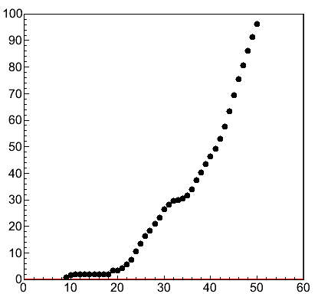
Algorithm (2/4)
Module map¶
  list of modules within maximal distance
number of modules
D_{max} [m]
¶ see <Jpp>/examples/JDetector/JModuleMapper

Slide 6
Algorithm (3/4)
L1
time
L0¶
T_{min}
T_{max}
¶|L1 - L0| ≤ D_{max}
maintain hit iterator for each L0 frame
increment hit iterator until hit->getT() >= T_{min}

Slide 7
Algorithm (4/4)
clusterize( .. , .. , JMatch3G)
L0
T_{min}
T_{max}
time

Slide 8
JTriggerMXShower

Slide 9
start iterators
JTimesliceClone<..> clone(inputL0, mapper);
for (JTriggerInput::const_iterator root = inputL1.begin(); root != inputL1.end(); ++root) {
buffer.clear();
const JList_t& zip = mapper.getList(root->getModuleID());
for (typename JList_t::const_iterator mod = zip.begin(); mod != zip.end(); ++mod) {
const double Tmin = root->getT() + mod->Tmin_ns;
const double Tmax = root->getT() + mod->Tmax_ns;
JFrame_t& frame = clone[mod->first];
frame.fast_forward(root->getT() - TMaxEvent_ns);
:
}
:
}
L0 buffer
associated modules
module attributes
direct indexing
increment iterator
strictly time ordered

Slide 10
JTimesliceClone<..> clone(inputL0, mapper);
for (JTriggerInput::const_iterator root = inputL1.begin(); root != inputL1.end(); ++root) {
:
for (typename JList_t::const_iterator mod = zip.begin(); mod != zip.end(); ++mod) {
:
for (typename JFrame_t::const_iterator i = frame.get(); *i <= Tmax; ++i) {
if (*i >= Tmin) {
buffer.push_back( JHitR1( frame.getModuleID(),
frame.getPosition(),
frame.getJHit(*i)));
}
}
}
:
}
fill L0 buffer

Slide 11
JTimesliceClone<..> clone(inputL0, mapper);
for (JTriggerInput::const_iterator root = inputL1.begin(); root != inputL1.end(); ++root) {
:
if (buffer.size() >= parameters.numberOfHits - 1) {
if (buffer.size() < parameters.factoryLimit) {
iterator q = clusterize(buffer.begin(), buffer.end(), match);
if (distance(buffer.begin(),q) >= parameters.numberOfHits - 1) {
// Trigger
}
} else {
// Trigger
}
}
}
test L0 buffer
factory limit
JMatch3G

Slide 12
JTriggerMXShower
parameters (with default values)
  triggerMXShower.enabled = 0;
  triggerMXShower.numberOfHits = 7;
  triggerMXShower.DMax_m = 43;
  triggerMXShower.TMaxExtra_ns = 20;

Slide 13
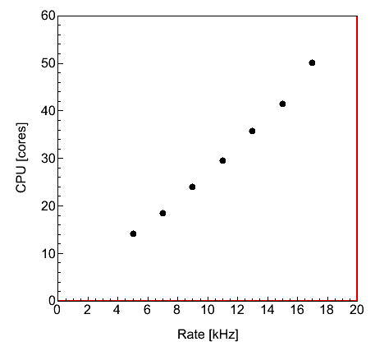
CPU◊ usage (1/2)
◊ Intel(R) Core(TM) i5-4570 CPU @ 3.20GHz

Slide 14
CPU◊ usage (2/2)
Level | Live time [ms] | CPU time [ms] | Ratio CPU/Live
calibration | 100 | 65 | < 1
L0 (sort) | 100 | 800 | 8
L1 | 100 | 25 | < 1
L2 | 100 | 70 | < 1
Time slice router | 100 | 100 | 1
Trigger | 100 | 400 | 4
Total | 100 | 1460 | 15
!
◊ Intel(R) Core(TM) i5-4570 CPU @ 3.20GHz
Random background as a function of multiplicity 5000, 500, 50, 5, 0.5 Hz, respectively

Slide 15
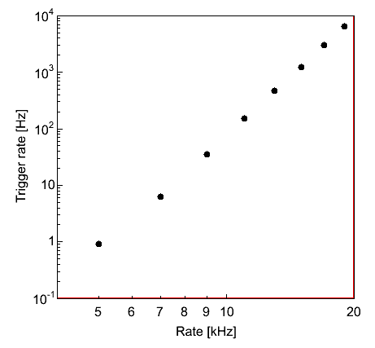

Random background
numberOfHits
=
$$y≅x^{7}$$

Slide 16
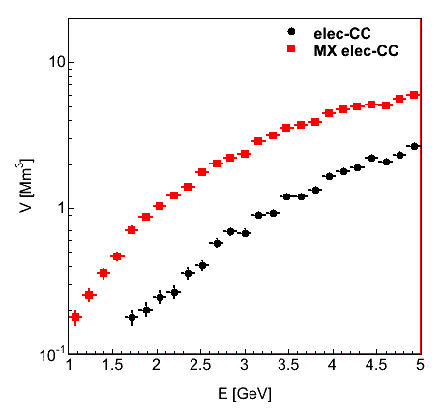
Effective volume ν_{e}

Slide 17
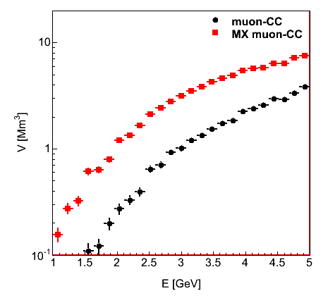
Effective volume ν_{μ}

Slide 18
Status & Outlook
New ORCA trigger available
  CPU power consumption very low
  reasonable purity
  improved efficiency
  input parameters to be (fine) tuned
Note that normalisation of ORCA Monte Carlo data
requires to process gSeaGen files

