Slide 1



Jpp Event-Weighting
Framework
A consistent event-weighting scheme for MC-combinations
Bouke Jung, Maarten de Jong

Slide 2
In a nutshell
Running a program over many different (types) of MC files is possible...
But not always practical or intuitive at the moment:
  Requires run-time classification and combination of (many different) file-headers
  Requires run-time assignment of correct (combined) weights to each event
A general Jpp-framework has been made available to accomplish the above
and avoid inconsistensies
  Inspired by Maarten's JHeadSet application and Alba and Alfonso's prior work
2021-02-09

Slide 3
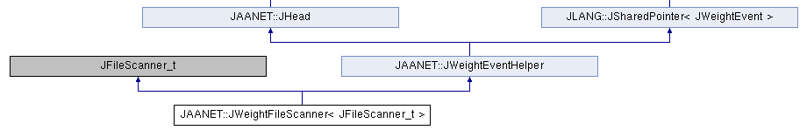
Software Structure
Top datastructure called "JWeightFileScannerSet"
  Ordered set of JWeightFileScanner objects
  Ordering guaranteed by JHead::less operator
A JWeightFileScanner object consists of:
  A filescanner which can be used to loop over all events corresponding to one MC-header type
  An event-weight helper, which does the bookkeeping on the combined header info
  and assigns the correct weight to each event correspondingly
JWeightFileScanner inheritance
2021-02-09

Slide 4
Software Structure
Top datastructure called "JWeightFileScannerSet"
  Ordered set of JWeightFileScanner objects
  Ordering guaranteed by JHead::less operator
A JWeightFileScanner object consists of:
  A filescanner which can be used to loop over all events corresponding to one MC-header type
  An event-weight helper, which does the bookkeeping on the combined header info
  and assigns the correct weight to each event correspondingly
Uses a pointer to an event weighter
JWeightFileScanner inheritance
2021-02-09

Slide 5
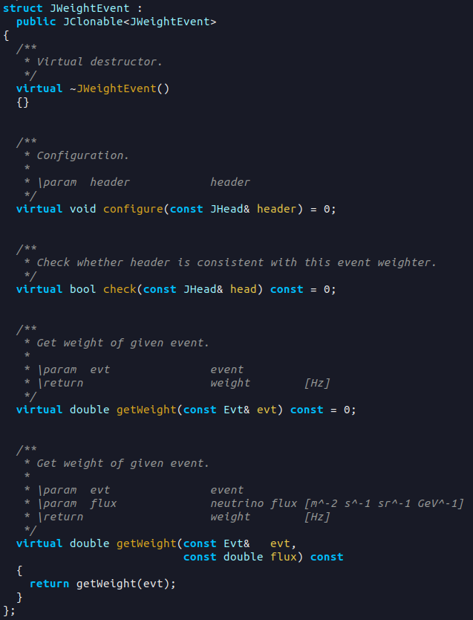
JWeightEvent
Simple interface containing three methods
  A configure-function, which sets the global event weight
  given a (combined) header
  A check-method to evaluate consistency of a header
  with this event weighter
  A getWeight-function which returns the correct
  weight (in Hz), given a MC-event
So far, three implementations
  Mupage weighter
  GSeaGen weighter
  KM3BUU weighter
2021-02-09

Slide 6
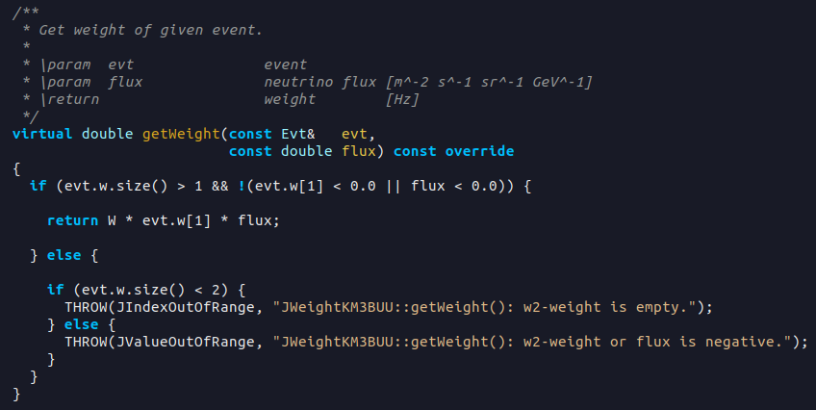
JWeightEvent
Simple interface containing three methods
  A configure-function, which sets the global event weight
  given a (combined) header
  A check-method to evaluate consistency of a header
  with this event weighter
  A getWeight-function which returns the correct
  weight (in Hz), given a MC-event
So far, three implementations
  Mupage weighter
  GSeaGen weighter
  KM3BUU weighter
Function-overloads
for user-specifiable flux
2021-02-09

Slide 7
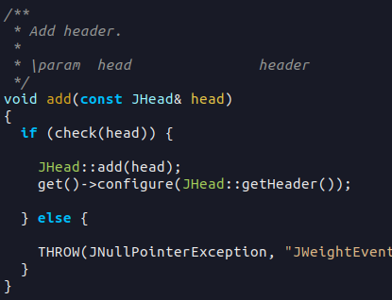
JWeightEventHelper
Manager of (combined) header information and event weighter
Provides configuration-, getWeight- and check-functions,
which call the underlying methods of JWeightEvent
Provides an addition-function, which combines a given header
with the current header info (if check OK)
and updates the global event weight
2021-02-09

Slide 8
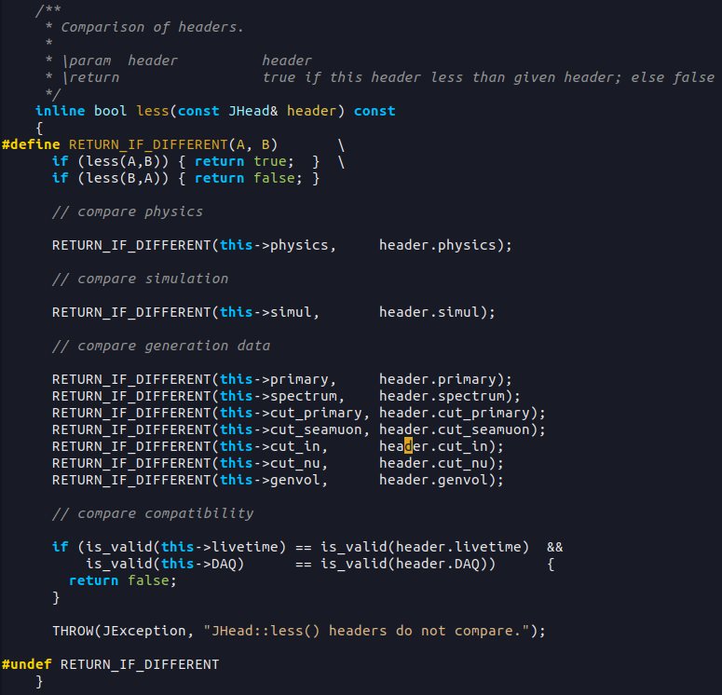
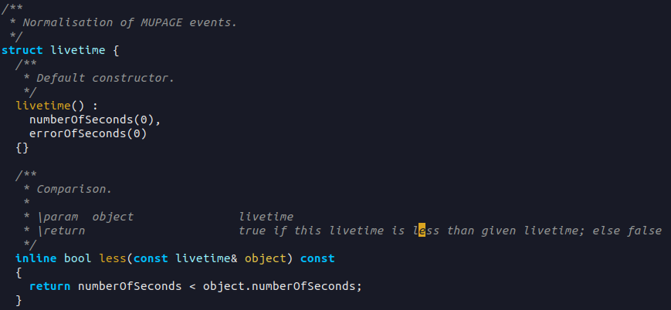
Header bookkeeping
Header ordering enabled by JHead::less
  Goes through all header fields
  Calls the associated less method, e.g.:
2021-02-09

Slide 9
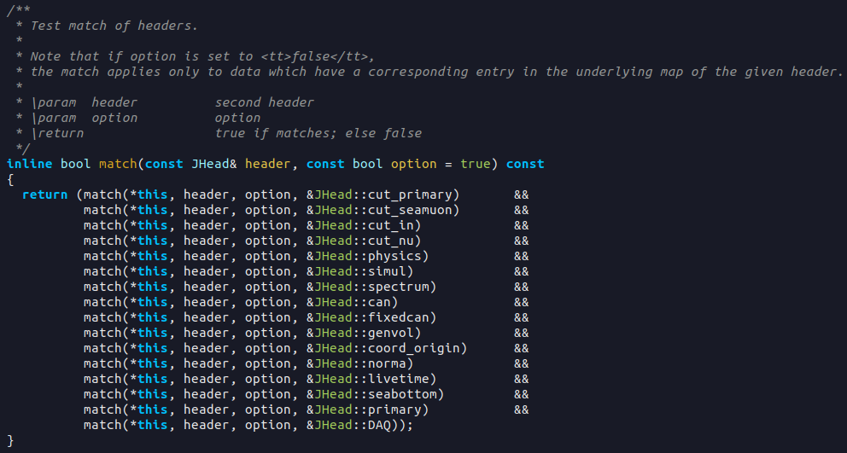
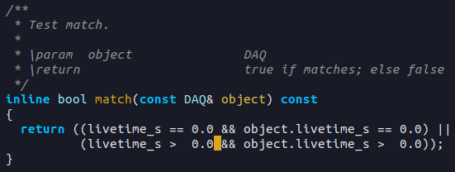
Header bookkeeping
Header ordering enabled by JHead::less
  Goes through all header fields
  Calls the associated less method
  Returns true if any field in given header
  smaller than the associated field of this header
Header matching enabled by JHead::match
  Goes through all header fields
  Calls the associated match method, e.g.:
2021-02-09

Slide 10
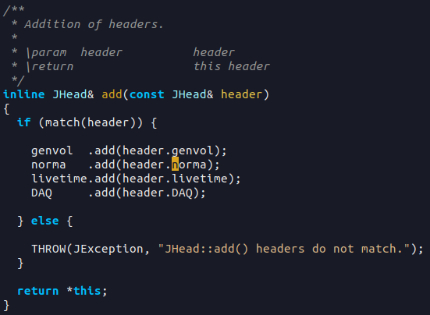
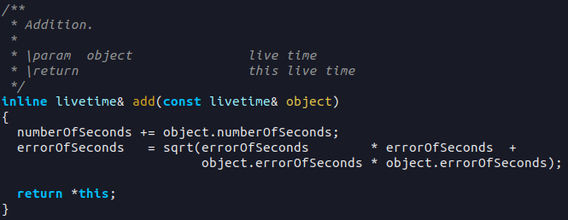
Header bookkeeping
Header ordering enabled by JHead::less
  Goes through all header fields
  Calls the associated less method
  Returns true if any field in given header
  smaller than the associated field of this header
Header matching enabled by JHead::match
  Goes through all header fields
  Calls the associated match method
  True if all header fields match
Addition via JHead::add
  Loops over relevant fields
  Adds associated variables, e.g.:
2021-02-09

Slide 11
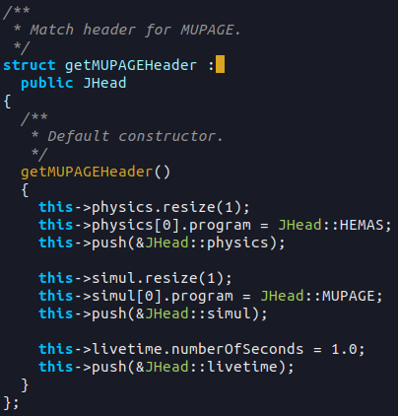
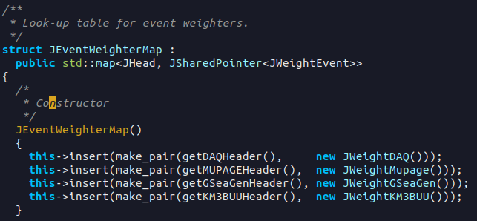
JEventWeighterMap
A mapping between the default MC-generator headers
and event weighters is provided in `JWeightEventToolkit.hh`
  Default headers implemented in `JHeadToolkit.hh`
  Two operators to retrieve the default weighter corresponding to a given header and vice versa
2021-02-09

Slide 12
JEventWeighterMap
A mapping between the default MC-generator headers
and event weighters is provided in `JWeightEventToolkit.hh`
  Default headers implemented in `JHeadToolkit.hh`
  Two operators to retrieve the default weighter corresponding to a given header and vice versa
Look-up operators can be called directly using two auxiliary function objects:
2021-02-09

Slide 13
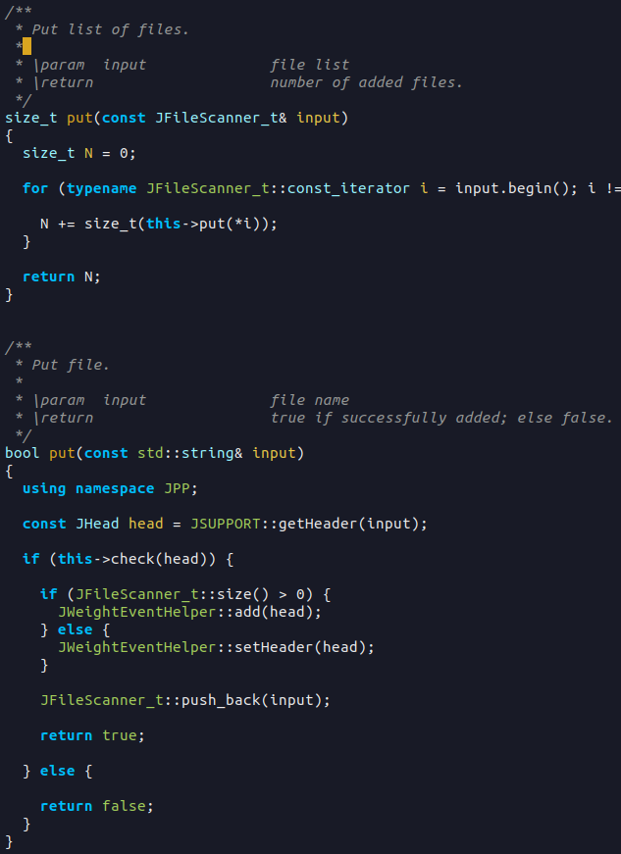
JWeightFileScanner
Under `$JPP_DIR/software/JSupport`
Configuration method for setting
the event weight helper
Two 'put'-methods for adding
single or multiple files to the list
and updating the event weighter
Note:
  Only files consistent with the
  set event weighter will be added
2021-02-09

Slide 14
JWeightFileScannerSet
= The crown to top it off
Takes a list (any mixture) of different MC-files and
  Combines the files of consistent header-types into individual JWeightFileScanner objects
  Orders the file-scanners according to the associated header-information
Available methods:
  Two put methods, to insert additional file(s)
  A get-function to retrieve the JWeightFileScanner object corresponding to a specific header
  A setLimit-function to limit the number of events read from each scanner (optional)
2021-02-09

Slide 15
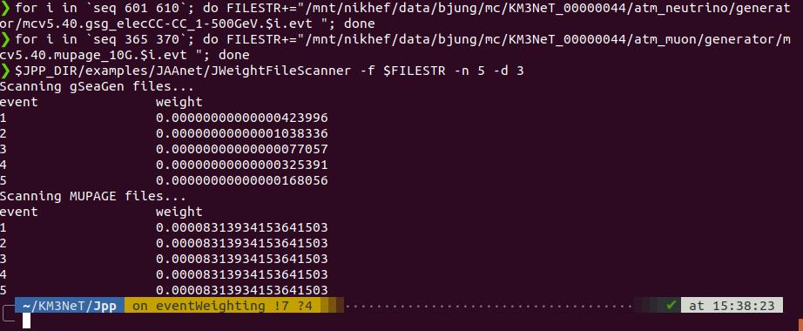
A simple working example...
An example program can be found under `$JPP_DIR/examples/JAAnet`
Allow scanning over any number of gSeaGen, KM3BUU or Mupage files and print out combined weights
2021-02-09

Slide 16
What's Next
Try using the framework on gSeaGen and KM3BUU input data
  W3-weight implementation for KM3BUU under development (thanks Johannes!)
  How to implement getWeight(const Evt& event, const double flux)
  for atmospheric tau-neutrino MC?
Allow scanning of DAQ-files also
  When combined with MC-info, may be used for inspection of e.g. trigger rate
Feedback and suggestions from the simulations working group are very relevant!
2021-02-09

Slide 17
What's Next
Try using the framework on gSeaGen and KM3BUU input data
  W3-weight implementation for KM3BUU under development (thanks Johannes!)
  How to implement getWeight(const Evt& event, const double flux)
  for atmospheric tau-neutrino MC?
Allow scanning of DAQ-files also
  When combined with MC-info, may be used for inspection of e.g. trigger rate
Feedback and suggestions from the simulations working group are very relevant!
  Which versions of which generators require which header fields?
  Do specific generators need additional customization of the weight-function?
E.g.:
gSeaGen v5.0 ORCA 115-string production stores generator name under 'physics' header-field
GSeaGen v5.40 ORCA 4-string production stores
generator name under 'simul' header-field
2021-02-09

Slide 18

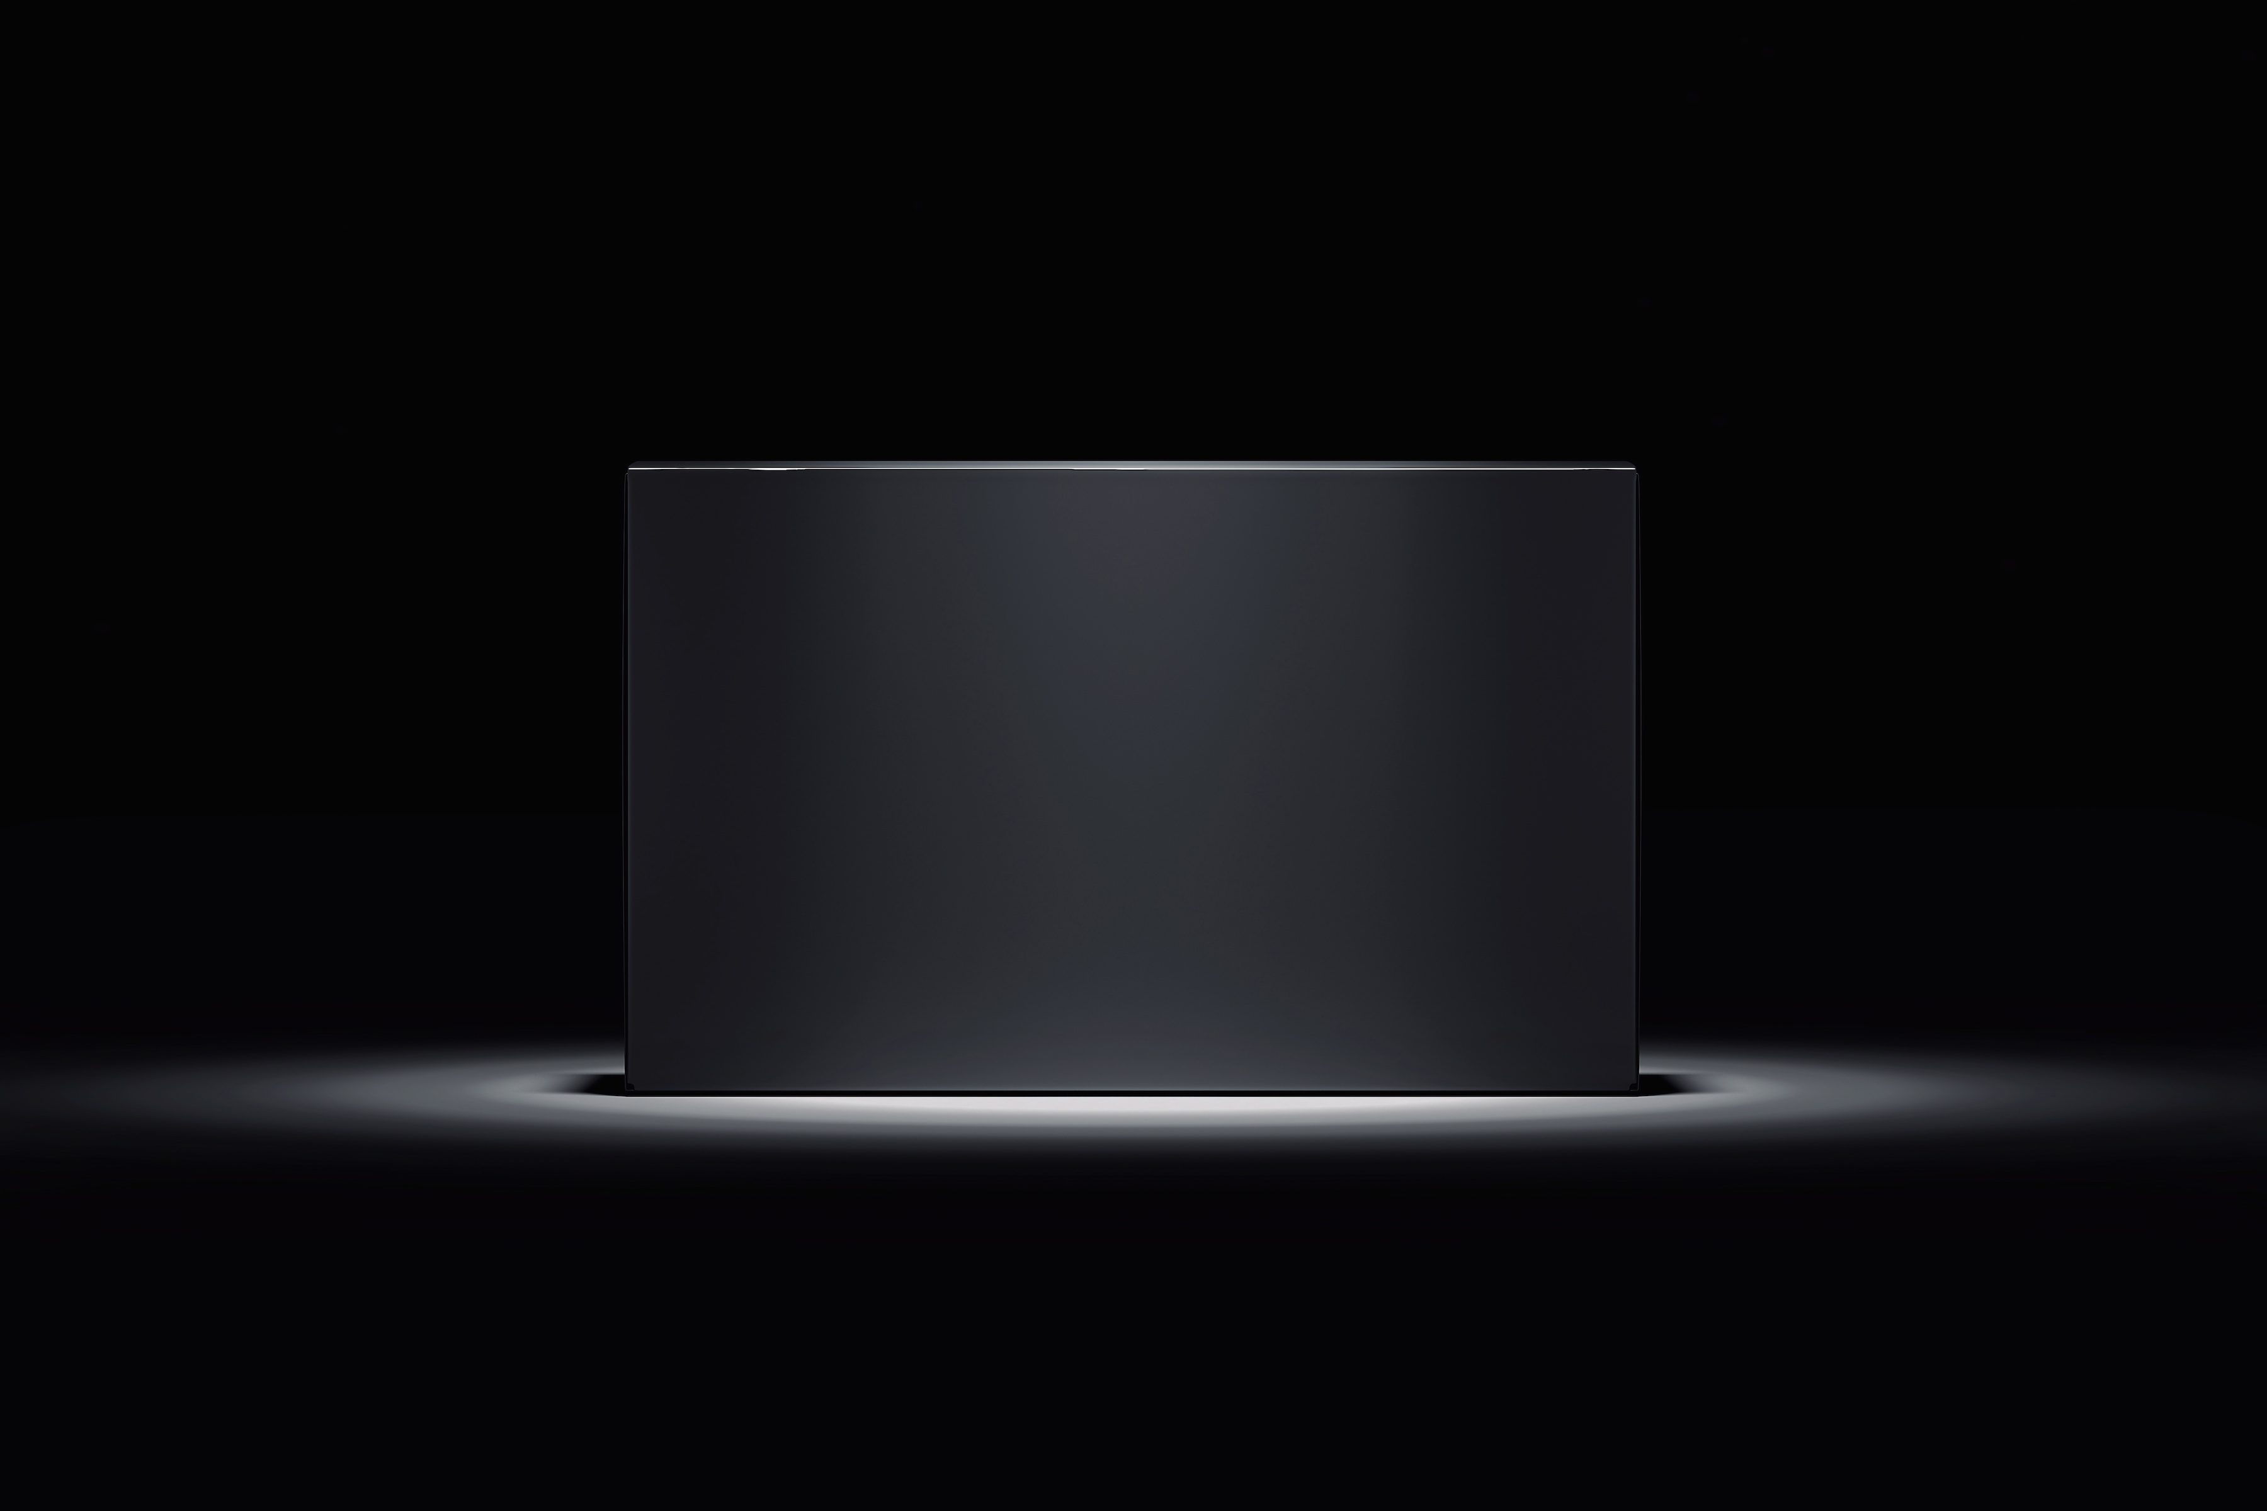

Summary
A common software-framework for MC event-weighting has been set up
NOT intended as a black-box, but hopefully can be used as
a means to (better) document, harmonize and standardize
the MC header formats and event weighting
2021-02-09

