Slide 1
Muon energy estimator
M . de Jong

Slide 2

Muon energy loss
ionisation
Bremsstrahlung

Slide 3
Contributions to light yield
Random background
Cherenkov light from muon
Cherenkov light from ionisation¶
Cherenkov light from Bremsstrahlung
¶ Not considered here.

Slide 4

PDF
number
of
photo-electrons
same
as
JGandalf

Slide 5

Light sources
random
background
Cherenkov light
from muon
Bremsstrahlung

Slide 6

Fit¶
¶ A M-estimator of χ² is used.

Slide 7



Probability

Slide 8
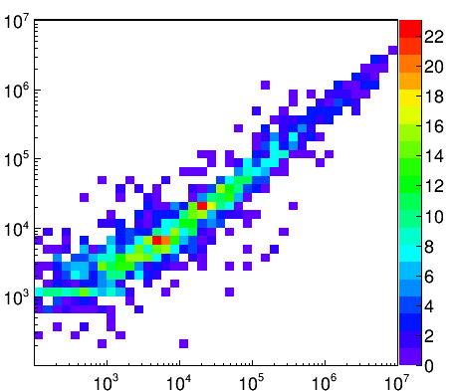
Energy estimate
“to guide
the eye”
E_{fit} [GeV]
E_{true} [GeV]

Slide 9
Energy correction
option -E <fcn>
  where <fcn> can be either:
    TFormula compatible expression
    ROOT file
      containing TFormula object with name “energy_correction”
    ASCII file
      containing TFormula compatible expression
uncorrected energy is available in user vector
  position JFIT::JENERGY_ENERGY

Slide 10
Summary & outlook
It is possible to estimate muon energy from PDFs
  no Monte Carlo information, no training, etc.
  provides also for a test of Monte Carlo simulation
Source code available in SVN
  <Jpp>/software/JFit/JEnergy.cc
Incorporate stochastic nature of energy loss
  neutrino interaction vertex!

