Slide 1
Trigger
M. de Jong
20/4/2020

Slide 2
“All-data-to-shore”
all analogue pulses from all PMTs that pass a pre-set threshold are timestamped off-shore;
all timestamped data are sent to shore;
all data are calibrated and filtered on shore in real time using a farm of commodity PCs;
all filtered and some summary data are distributed and saved on persistent media for further analyses;

Slide 3
Applications (1/3)
JDataFilter
real time filtering of detector data (not this talk)
JRandomTimesliceWriter
produce time slices with random data
JTriggerProcessor
offline filtering of detector data
JTriggerReprocessor
reprocess triggered data

Slide 4
Applications (2/3)
JTriggerEfficiency
processing of Monte Carlo data
output of km3, KM3Sim, JSirene, …
addition of random background
JEventTimesliceWriter
processing of Monte Carlo data
output of K40 simulations
addition random background (e.g. singles rates)

Slide 5
Applications (3/3)
JSummary
convert real summary data to summary data suitable for simulations
output of ARCA or ORCA detector
JTriggerMonitor
print trigger statistics
JTrigger
provides statistical information about the signal processing during detector simulation of JTriggerEfficiency
possible explanation why there are no triggered events

Slide 6
JRandomTimesliceWriter
command line options
-a <detector file>
-B "R₁ [R₂ [R₃ [...]]]" // background
-o <output file> // time slice data
-P "%.QE=<value>; // PMT simulation pmt=<module> <address> QE=<value>; "
-P <PMT simulation file>
wild card

Slide 7
JTriggerProcessor
command line options
-a <detector file>
-f <input file> // time slice data (see below)
-@ "<trigger parameter>=<value>; …"
-@ "<trigger parameter file>"

Slide 8
JTriggerEfficiency (1/2)
command line options
-a <detector file>
-f <Monte Carlo event file>
-@ "<trigger parameter>=<value>; …"
-@ "<trigger parameter file>"
-P "%.QE=<value>; // PMT simulation
pmt=<module> <address> QE=<value>;"
-P <PMT simulation file>
-S <seed>
-O <triggeredEventsOnly>

Slide 9
JTriggerEfficiency (2/2)
command line options
-B "R₁ [R₂ [R₃ [R₄ ]]]" // background rates [Hz]
-r "file=<file name>" // run-by-run simulation
-r <run-by-run simulation file>
N.B. singles rates from run-by-run data (option -r) prevails but multiples rates are taken from option -B

Slide 10
JSummary
command line options
-f <raw data file> // real data
-a <detector file> // for simulations
-n <number of slices>
-o <output file>

Slide 11
JEventTimesliceWriter
command line options
-f <K40 event file> // coincidence data
-o <output file> // time slice data
-r <event rate [Hz]>
-B "R₁ [R₂ [R₃ [R₄ ]]]" // background rates [Hz]
-P "%.QE=<value>; // PMT simulation pmt=<module> <address> QE=<value>;"
-P <PMT simulation file>

Slide 12
Detector (1/1)
Data structures
JDetector : std::vector<JModule> {};
JModule : std::vector<JPMT> {};
JPMT : JObjectID, JAxis3D, JCalibration {};
JModuleRouter
O(1) access to module data
JModule getModule(<module identifier>);
JPMTRouter
O(1) access to PMT data
JPMT getPMT(<PMT identifier>);
JDAQHitRouter
O(1) access to PMT data
JPMT getPMT(JDAQKeyHit&);

Slide 13
Data format (1/4)
class JDAQHit
{
getPMT(); // get PMT (0, …, 30)
getT(); // get time [ns]
getToT(); // get time-over-threshold [ns]
};
class JDAQFrame // low-level data frame
{ // one per optical module
const_iterator begin();
const_iterator end();
bool empty();
int size();
const JDAQHit& operator[](int);
};
mimics std::vector<>

Slide 14
Data format (2/4)
class JDAQSuperFrame : // high-level data frame
// one per optical module
..
JDAQSuperFrameHeader, // run number, etc.
JDAQFrame // PMT data
{};
class JDAQTimeslice : // all data there are
..
JDAQTimesliceHeader, // run number, etc.
vector<JDAQSuperFrame> // PMT data
{};

Slide 15
Data format (3/4)
class JDAQSummaryFrame : // summary information
.. // one per optical module
JDAQModuleIdentifier,
JDAQFrameStatus
{
bool testDAQStatus(); // UDP packet test
bool testWhiteRabbitStatus(); // White Rabbit test
bool testHighRateVeto(); // high-rate veto (do this first)
bool testHighRateVeto(int tdc); // high-rate veto
double getRate(int tdc); // rate [Hz]
};

Slide 16
Data format (4/4)
class JDAQSummaryslice : // all summary information .. // there is
JDAQSummarysliceHeader,
vector<JDAQSummaryFrame>
{
JDAQSummaryslice( JDAQTimeslice); // build summaries
};

Slide 17
Data processing (1/6)
global methods
double getTime( t [ns], JCalibration) {}
double putTime( t [ns], JCalibration) {}
auxiliary methods
double getTime(JDAQHit, JCalibration) {}
sign convention

Slide 18
Data processing (2/6)
JDAQFrame
contains all data from one optical module within pre-set time window (= frame time)
$\left\{{⋯,\left(\text{JDAQHit}\right)}_{i},{\left(\text{JDAQHit}\right)}_{i+1},⋯\right\}$;
specification
$$∀ \left(i, j\right) \text{where} i<j ∧ {\text{JDAQHit}\text{::}\text{getPMT}\text{()}}_{i}={\text{JDAQHi}\text{t}\text{::}\text{getPM}\text{T}\text{()}}_{j}$$
$⟹ {\text{JDAQHit}\text{::}\text{get}\text{T}\text{()}}_{i}<{\text{JDAQHit}\text{::}\text{get}\text{T}\text{()}}_{j}$

Slide 19
Data processing (3/6)
first step
convert 1-dimensional mixed array of DAQ hits to collection of time calibrated and time sorted 1-dimensional arrays per PMT
additional steps
merge collection of 1-dimensional arrays to single time sorted 1-dimensional array
apply coincidence logic

Slide 20
Data processing (4/6)
first step (2)
class JSuperFrame2D :
JModuleHeader,
vector<JFrame> // time calibrated data
{
JSuperFrame1D& operator()( JDAQSuperFrame&,
JModule&);
static JSuperFrame2D<> demultiplex; // Demultiplexer
};
I/O operator

Slide 21
Data processing (5/6)
additional steps (2)
class JSuperFrame1D :
JModuleHeader,
vector<JElement_t> // time calibrated data
{
JSuperFrame1D& operator()( JSuperFrame2D&);
static JSuperFrame1D<> multiplex; // Multiplexer
};
I/O operator

Slide 22
Data processing (6/6)
additional steps (2)
JBuildL0<>
convert raw data to JHitL0 data
JHitL0 : JDAQPMTIdentifier, JAxis3D, JHit {};
JBuildL1<>
convert raw data to compressed L1 data
convert raw data to JHitL1 data
JHitL1 : vector<JHitL0> {};
JBuildL2<>
select subset of L1 data
multiplicity of L1
maximal angle between PMT axes

Slide 23
Hit clustering (1/2)
clusterize(.., JMatch&)
count number of friends;
remove element with least number of friends;
stop when least number of friends = number of elements;
reverse_clusterize(.., JMatch&)
count number of friends;
keep element with most number of friends;
stop when most number of friends = number of elements;
clusteriseWeight(.., JMatch&)
idem using weight of elements

Slide 24
Hit clustering (2/2)
JMatch3D
simple causality
JMatch3G
causality for shower with distance dependent time window (improvement due to J. Hofestädt)
JMatch3B
causality for muon with distance dependent time window (improvement due to B. Bakker)
JMatch1D
causality for muon along z-axis

Slide 25
Accidental coincidence rate (1/2)
number of sources
rate of each source
$$R\left(m\right)=\left(\begin{matrix}N \\ m\end{matrix}\right)×f×{\left(f×∆T\right)}^{m−1}$$
$$≅\frac{N^{m}}{m!}×f×{\left(f×∆T\right)}^{m−1}$$
minimum cluster size
$$=\frac{1}{m!}×Nf × {\left(Nf×∆T\right)}^{m−1}$$
Total rate
Probability

Slide 26
Accidental coincidence rate (2/2)
$$R\left(m\right)=\frac{1}{m!}×Nf × {\left(Nf×∆T\right)}^{m−1}$$
3D
1D
$$∆T=\frac{nD}{c}≅5 μs$$
$$∆T=\frac{nR}{c}≅0.5μs$$
$$N_{L1}=115×18=2070$$
$$N_{L1}≅50$$
$$f_{L1}≅1 kHz$$
$$f_{L1}≅1 kHz$$

Slide 27
Trigger logic (1/1)
Level 1
JBuildL1 local coincidences (Δt)
Level 2
JBuildL2 local coincidences (Δt; cos(θ); M ≥ 2)
Level 3
trigger3DMuon
trigger3DShower
…
Merge events
overlap in time
JDAQEvent::getOverlays()
multiple trigger algorithms can be applied to the same data

Slide 28
JTriggerEfficiency
initialisation
detector geometry and calibration
setup detector simulation
event loop
input Monte Carlo event
add background
create JDAQTimeslice
calibrate data
application of trigger(s)
output JDAQEvent
output JDAQSummaryslice
termination
close files
handled via interfaces,
see next slides
same as JDataFilter and JTriggerProcessor

Slide 29
Interfaces
JK40Simulator
generation of random background
virtual void generateHits(JModule, JTimeRange, JModuleData& output);
JModuleData : vector< JPMTData<JPMTSignal> > {};
JPMTSimulator
simulation of PMT
virtual void processHits( JPMTIdentifier, JCalibration, JStatus,
JPMTData<JPMTSignal>& input,
JPMTData<JPMTPulse>& output);
JCLBSimulator
Simulation of CLB
typedef vector< JPMTData<JPMTPulse> > JCLBInput;
virtual void processData(JModuleIdentifier, JCLBInput input, JDAQSuperFrame& output);

Slide 30
JK40DefaultSimulatorInterface
implements
JK40Simulator
interface methods
virtual double getSinglesRate(JPMTIdentifier);
virtual double getCoincidenceRate(JModuleIdentifier, multiplicity);
virtual double getProbability(cos(θ));

Slide 31
JPMTDefaultSimulatorInterface
implements
JPMTSimulator
interface methods
virtual bool getPMTstatus(JPMTIdentifier, JTimeRange, // time dependence
JStatus); // on/off
virtual JPMTSignalProcessorInterface // see next slide getPMTSignalProcessor(JPMTIdentifier);

Slide 32
JPMTSignalProcessorInterface
interface methods
virtual bool applyQE(); virtual double getRandomTime(double t_ns);
virtual bool compare(JPhotoElectron, JPhotoElectron);
virtual double getRandomCharge(int NPE);
virtual JChargeDomains applyThreshold(double npe);
virtual double getTimeOverThreshold(double npe);
virtual double getSurvivalProbability(int NPE);
virtual void merge(JPMTData<JPMTHit>&);

Slide 33
JCLBDefaultSimulatorInterface
implements
JCLBSimulator
interface methods
virtual JDAQHit JTDC::makeHit(JPMT_t, double, JTOT_t); // non-linearity
virtual bool JStateMachine::maybeSwapped(JDAQHit, JDAQHit); // state machine
virtual int getUDPNumberOfReceivedPackets(JModuleIdentifier); virtual int getUDPMaximalSequenceNumber(const JModuleIdentifier); virtual bool hasUDPTrailer(const JModuleIdentifier); virtual bool getHighRateVeto(JPMTIdentifier); // high-rate veto

Slide 34
Available implementations (1/3)
JK40DefaultSimulator
single rates
multiple rates
angular dependence of coincidence rates
JPMTAnalogueSignalProcessor
transition time spread
gain spread
threshold
time-over-threshold
hit merging

Slide 35
Available implementations (2/3)
JCLBDefaultSimulator
TDC non-lenarity
hit re-shuffling

Slide 36
Available implementations (3/3)
JK40RunByRunSimulator :
JK40DefaultSimulator
single rates from real data
multiple rates
angular dependence of coincidence rates
JPMTRunByRunSimulator :
JPMTDefaultSimulator
PMT status from real data
JCLBRunByRunSimulator :
JCLBDefaultSimulator
high-rate veto from real data

Slide 37
Detector simulation
JDetectorSimulator :
JPMTRouter, // fast access to PMT data
JK40Simulator,
JPMTSimulator,
JCLBSimulator
{
JDetectorSimulator(JDetector); // input detector
protected:
std::auto_ptr<JK40Simulator> k40Simulator;
std::auto_ptr<JPMTSimulator> pmtSimulator;
std::auto_ptr<JCLBSimulator> clbSimulator;
};
set your favourite simulator

Slide 38
PMT simulation (1/1)
JMonitorK40
-f <input file> // JDAQTimeslice
-o <output file> // histograms
JFitK40
-f <input file> // histograms
-P <PMT efficiency file> //
PMT efficiency file can be input to JTriggerEfficiency, JEventTimeslice, JRandomTimesliceWriter

Slide 39
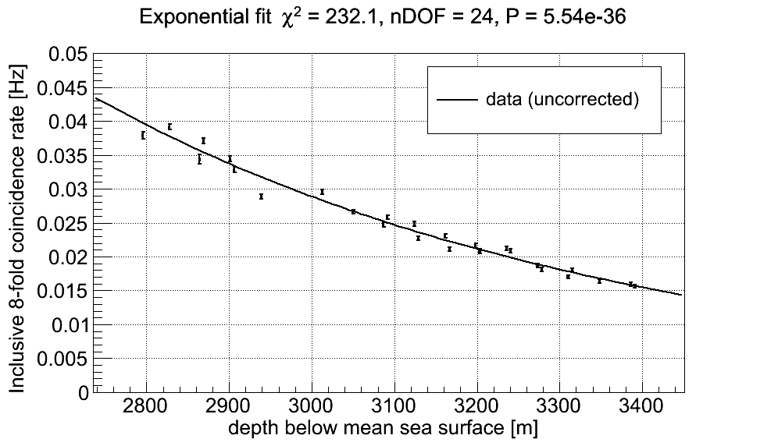
Muon depth dependence (1/1)
0.05
0.04
0.03
0.02
0.01
0.0
KM3NeT
data
fit
Rate [Hz]
2.8
2.9
3.0
3.1
3.2
3.3
3.4
Depth [km]

Slide 40
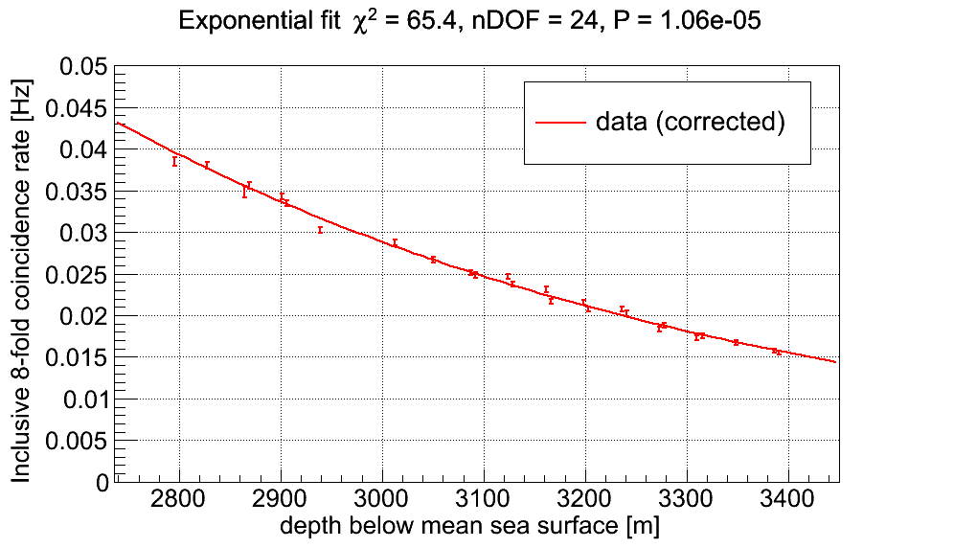
Muon depth dependence (1/1)
0.05
0.04
0.03
0.02
0.01
0.0
KM3NeT
data (corrected)
fit
Rate [Hz]
2.8
2.9
3.0
3.1
3.2
3.3
3.4
Depth [km]

Slide 41
Time slice (1/1)
class JEventTimeslice :
JDAQTimeslice // as raw data (!)
{
JEventTimeslice( JDAQChronometer, // RUN number, etc.
JDetectorSimulator, // detector simulation
Event, // Monte Carlo event
[JTimeRange]); // time window
};

Slide 42
Event (1/6)
JDAQEvent :
JDAQChronometer,
JDAQTriggerCounter, // real data: unique per thread
// Monte Carlo: index to TTree
JDAQTriggerMask // trigger bits of event
{
const_iterator<..> begin<..>();
const_iterator<..> end<..>();
unsigned int size<..>();
unsigned int getOverlays();
protected:
std::vector<JDAQTriggeredHit> triggeredHits;
std::vector<JDAQSnapshotHit> snapshotHits;
};
<..> select data type

Slide 43
Event (2/6)
JDAQTriggerMask {}; // 64 bit coded word, 1 bit per trigger // macro setTriggerBit(<trigger>, <bit>);
JDAQKeyHit :
JDAQModuleIdentifier, // module JDAQHit // PMT hit {};
typedef JDAQKeyHit JDAQSnapshotHit; // snap shot hit
JDAQTriggeredHit : // triggered hit
JDAQKeyHit, // same as snapshot hit JDAQTriggerMask // trigger bits of hit
{};

Slide 44
Event (3/6)
trigger(s)
snapshot
{JDAQSnapshotHit,
{JDAQTriggeredHit}
,JDAQSnapshotHit}
{ hit }
T_{min} - ΔT
T_{min}
T_{max}
T_{max} + ΔT
time
snapshot¶ = All raw data between [T_{min} - ΔT, T_{max} + ΔT]
¶ ΔT = nD/c (where D corresponds to size of detector)

Slide 45
Event (4/6)
T_{max}
{JDAQTriggeredHit}
T_{max}
T_{min}
{JDAQTriggeredHit}
T_{min}
{JDAQTriggeredHit}
JDAQTriggeredHit :
.. JDAQTriggerMask // ORed
{}
JDAQEvent :
..
JDAQTriggerMask // ORed
{
unsigned int getOverlays(); // incremented
};

Slide 46
Event (5/6)
class JTriggeredEvent :
JDAQEvent // I/O
{
JTriggeredEvent( JEvent, // internal to trigger
JTimesliceRouter, // see next slide
TMaxLocal_ns, // L1 time window
[snapshot]); // option
};

Slide 47
Event (6/6)
class JTimesliceRouter :
JPointer<const JDAQTimeslice> // pointer to raw data
{
configure(JDAQTimeslice); // input
JDAQFrameSubset getFrameSubset( JDAQModuleIdentifier, JTimeRange);
};
subset of JDAQSuperFrame

Slide 48
Examples (1/4)
JSignalL1 & JRandomL1
test efficiency and purity of L1−L2 coincidence logic
JFilter
test efficiency and purity of cluster methods
JVolume1D
plot trigger effective volume

Slide 49
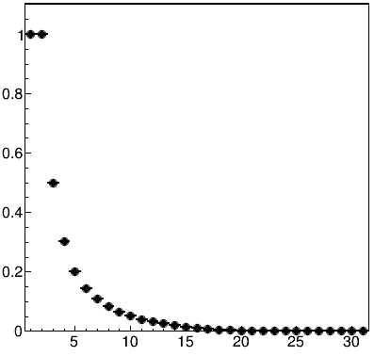
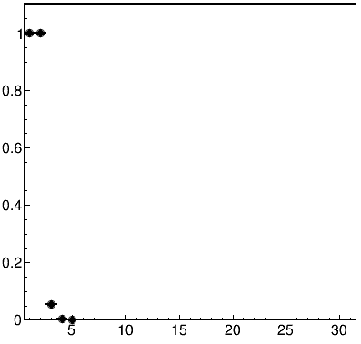
Examples (2/4)
JSignalL1.sh
JRandomL1.sh
efficiency
efficiency
number of hits
number of hits

Slide 50
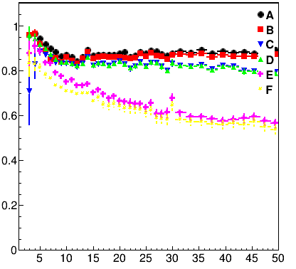
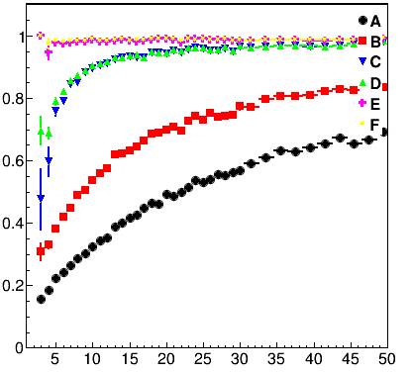
Examples (3/4)
JFilter.sh
efficiency
purity
number of hits
number of hits

Slide 51
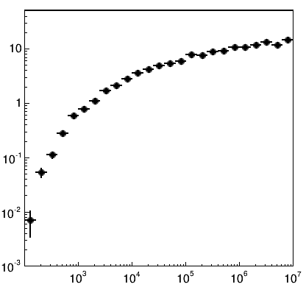
Examples (4/4)
JVolume1D.sh
Volume [km³]
E_{ν} [GeV]

