Slide 1
JPMTAnalogueSignalProcessor
PMT analogue signal processor in Jpp
M. de Jong

Slide 2
Introduction (1/1)
Signal processing
PMT
analogue discriminator digital TDC data
ASIC
FPGA
time of leading edge [ns]
time-over-threshold [ns]

Slide 3
Introduction (2/3)
$$1$$
definition
gain spread
amplitude [p.e.]
$$\sim 0.3$$
threshold
time-over-threshold
time

Slide 4
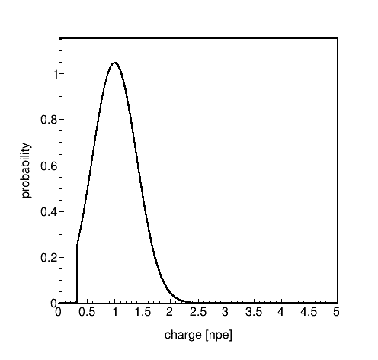
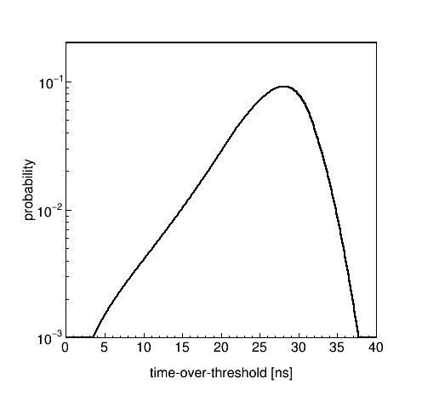
Introduction (3/3)
simulation
charge
time-over-threshold
gain spread
gain
calibration

Slide 5
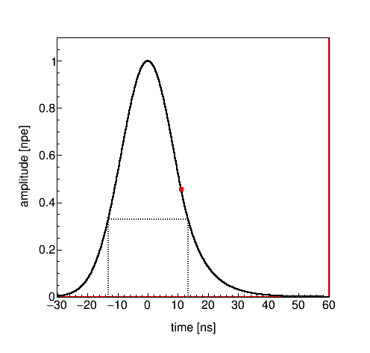

Model (1/6)
Leading edge = Gaussian
$f\left(x\right)=e^{−\frac{1}{2}{\left(\frac{x}{σ}\right)}^{2}}$
Trailing edge = exponent
$g\left(x\right)=e^{\frac{1}{2}{\left(\frac{λ}{σ}\right)}^{2}}×e^{−x/λ}$
Specification: $T_{1pe}≡26.4 \text{ns}$
$T=g^{−1}\left(y_{0}\right)−f^{−1}\left(y_{0}\right)$
relates $σ$ and $λ$
constraints $σ$
definition
$$f\left(x_{1}\right)=g\left(x_{1}\right)$$
$$f^{′}\left(x_{1}\right)=g^{′}\left(x_{1}\right)$$
$$y_{0}$$
$$T_{1pe}$$

Slide 6
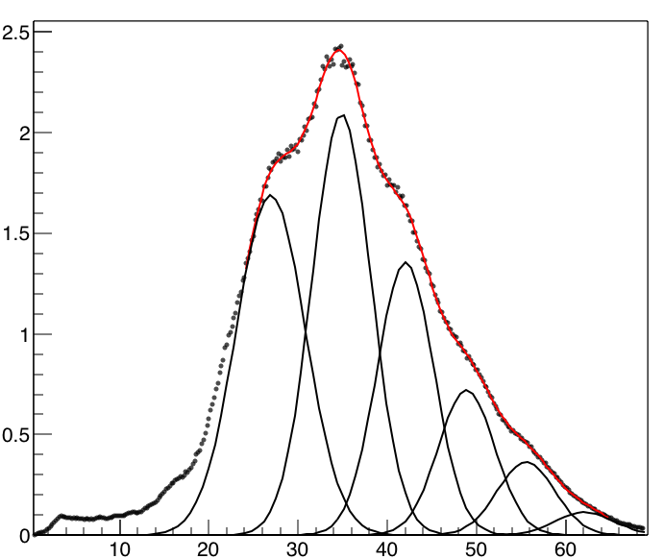
Model (2/6)
2
peak | ns
1 | 27
2 | 35
3 | 42
4 | 49
5 | 56
6 | 62
Bram Schermer
(Nikhef)
$$\left\langle \text{npe}\right\rangle ≅2.2$$
1
3
number of hits [a.u.]
4
5
6
time over threshold [ns]

Slide 7
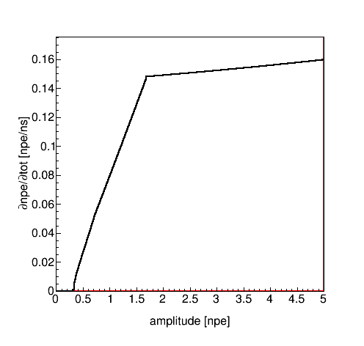
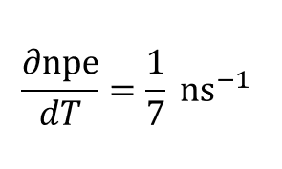
Model (3/6)
effect of saturation¶
kink is equivalent of clipping of voltage at amplifier output
$$⟹ T ∝ \text{charge}$$
determination of transition point requires iterative procedure
few steps suffices
model forced linearization
¶ See next slides.

Slide 8
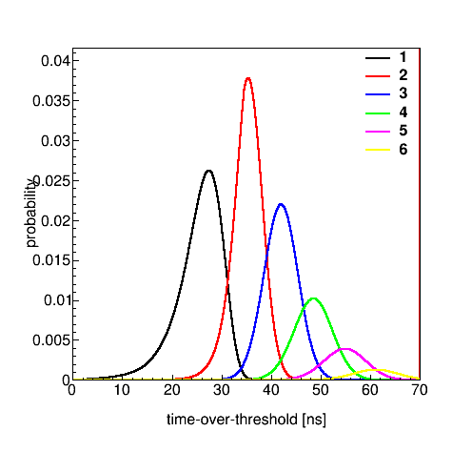
Model (4/6)
Model for given number of photo-electrons
number of hits [a.u.]
time over threshold [ns]

Slide 9
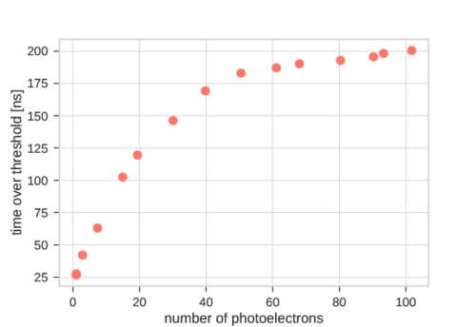
Model (5/6)
Saturation
$x^{′}=x × \frac{c}{\sqrt{x^{2}+c^{2}}}$
$x≡$ time-over-threshold
J. Reubelt (Erlangen)

Slide 10
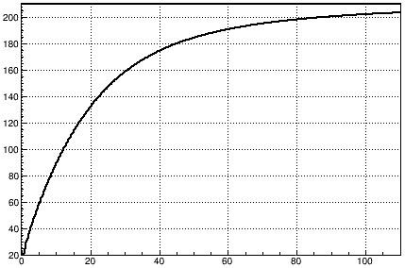
Model (6/6)
Saturation
$c≅210 \text{ns}$
good agreement

Slide 11
Results (1/4)
input KM3NeT_00000014_00005282.root (L0 data)
old = Jpp trunk (11531)
new = this analysis

Slide 12
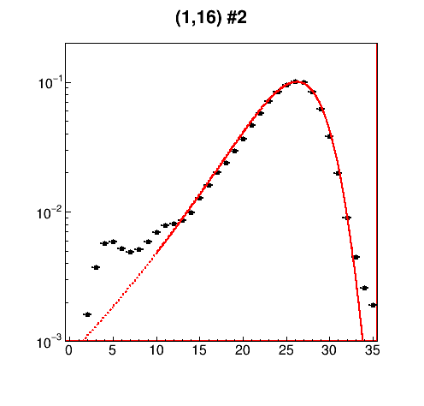
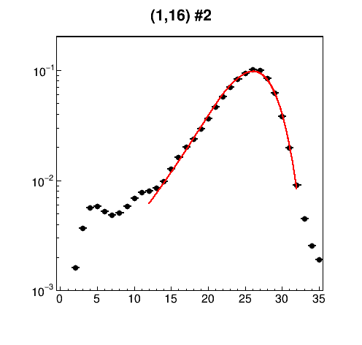
Results (2/4)
old
new
gain = 0.88
spread = 0.33

Slide 13
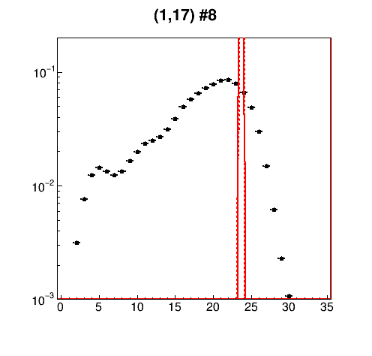
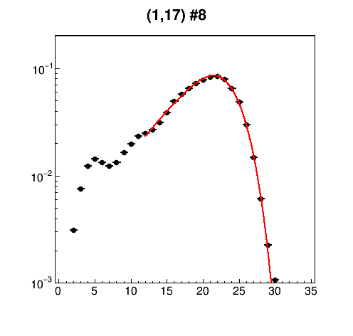
Results (3/4)
old
new
gain = 0.59
spread = 0.37

Slide 14
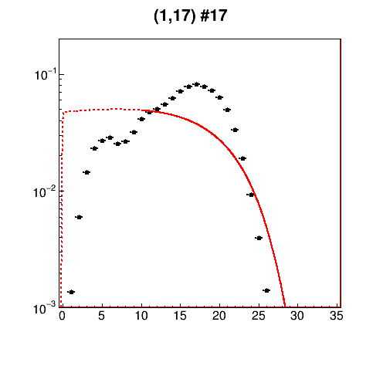
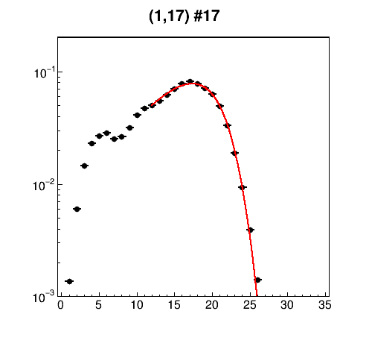
Results (4/4)
old
new
gain = 0.43
spread = 0.38

Slide 15
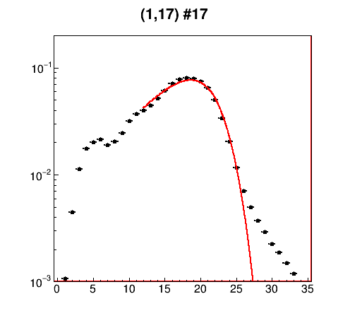
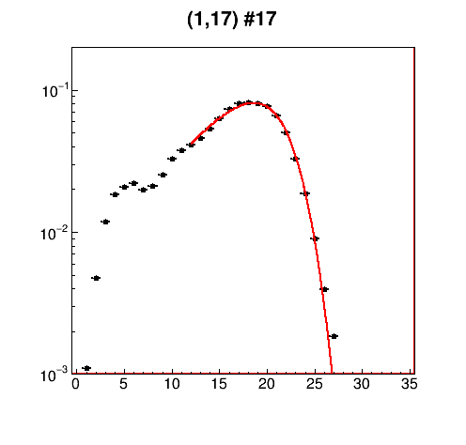
L1 data selection¶ (1/1)
$$\cos{∡ \text{PMT} \text{axes}}≤1.0$$
$$\cos{∡ \text{PMT} \text{axes}}≤0.0$$
χ² = 33354
gain = 0.46
spread = 0.42
χ² = 3046
gain = 0.48
spread = 0.37
¶ KM3NeT_00000014_00005009.root

Slide 16
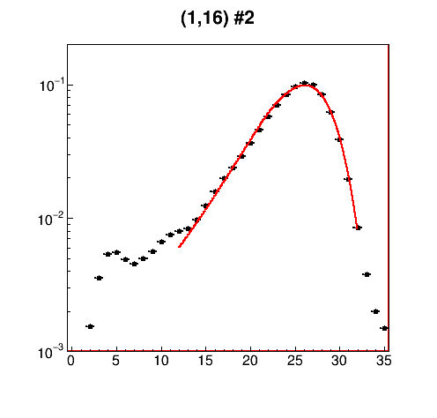
Comparison L0 – L1 data (1/3)
L0
L1
χ² = 1461
gain = 0.88
spread = 0.33
χ² = 2189
gain = 0.89
spread = 0.33

Slide 17
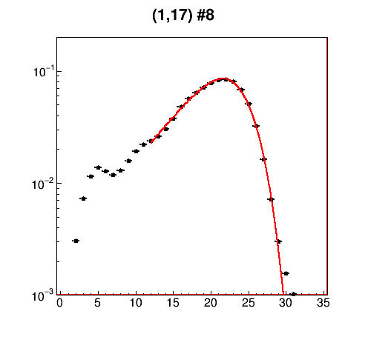
Comparison L0 – L1 data (2/3)
L0
L1
χ² = 1097
gain = 0.59
spread = 0.37
χ² = 2271
gain = 0.60
spread = 0.38

Slide 18
Comparison L0 – L1 data (3/3)
L0
L1
χ² = 1201
gain = 0.43
spread = 0.38
χ² = 3046
gain = 0.48
spread = 0.37

Slide 19
Backward compatibility (1/2)
New model has less parameters than old model
QE; gain; gain spread; rise time; TTS; threshold; offset; slope; curvature; and saturation
I/O of model parameters backward compatible (PMT efficiency file)
QE; gain; gain spread; rise time; TTS and threshold

Slide 20
Backward compatibility (2/2)
Some parameters of new model should have different values¶
threshold $\sim 0.3$ pe
rise time $\sim 8.5$ ns
Future proofness
convert existing files by hand§
overwrite threshold and rise time upon reading file
¶ Rise times in current PMT files exceeds maximal value.
§ Tool could be provided.

Slide 21
Summary & Outlook (1/2)
ARCA2 data were taken with too low HVs on various PMTs
causes a deficiency, most notably culprit(s) in analysis of depth dependence of atmospheric muons
To measure gain [and gain spread] of PMT, one needs to model time-over-threshold distribution
new model seems to reliably work for any gain
can be applied to L0 as well as L1 data

Slide 22
Summary & Outlook (2/2)
Next steps (in this order)
implement the new model as default in Jpp
tune common parameters (threshold, rise time and fit range)
test fits on large number of PMTs and runs (à la QE fits)
measure gain per PMT (new)
re-measure QE per PMT (as before, but will yield different values)
simulate detector response (JTriggerEfficiency)
redo data – Monte Carlo comparisons

